Slide 1
Lukas Wallrich (l.wallrich@bbk.ac.uk) .
Questionable Research Practices
Avoiding temptation, producing robust findings

Slide 2
Purpose of the session
Understand the replication crisis
Review one cause:
Questionable Research Practices
Consider how to avoid them in your own research

Slide 3
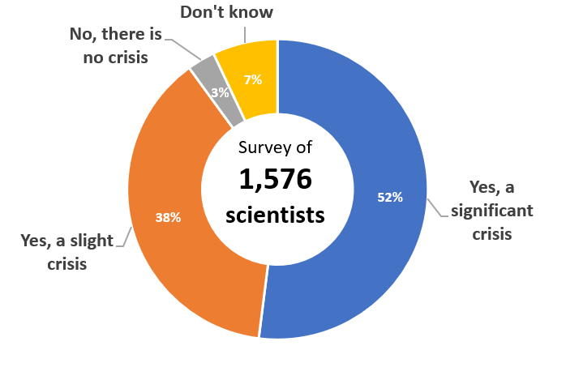
Address replication crisis
Nature survey: is there a reproducibility crisis?
Notes:
Mix of problematic research practices, misunderstandings, and wrong motivations …

Slide 4
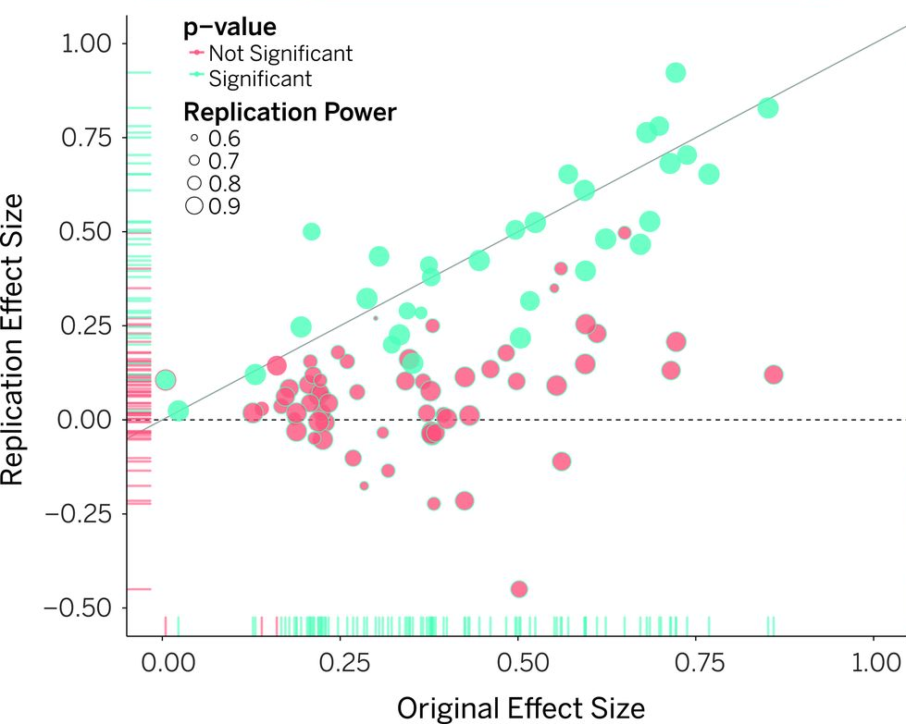
Estimating the reproducibility of psychological science (2015)
Notes:
1/3 reproducible
Average effect size: ½ of original effect size
https://www.science.org/doi/10.1126/science.aac4716

Slide 5
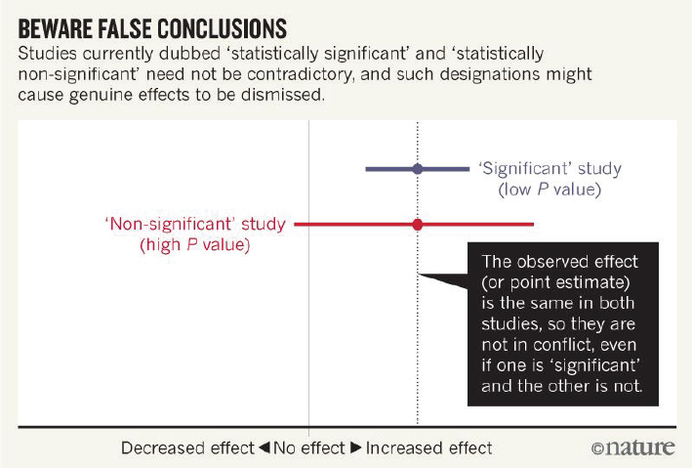
A caveat
Notes:
1/3 reproducible
Average effect size: ½ of original effect size
https://www.science.org/doi/10.1126/science.aac4716

Slide 6
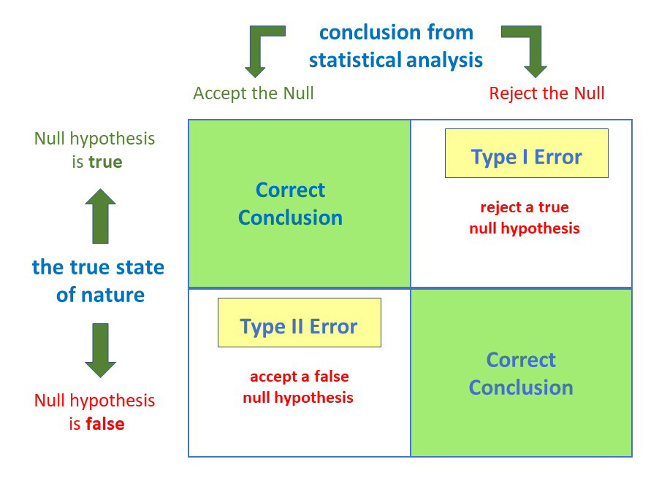
Another caveat: base rates matter
5% of row
80% of row
Maximum (true) replication rate of significant results: share of correct rejections
Depends on share of true hypotheses

Slide 7
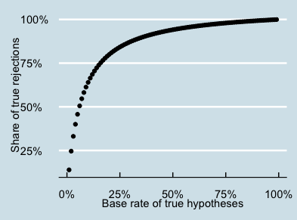
Another caveat: base rates matter
Possibly main problem in some fields – read more

Slide 8
Our field might be particularly troubled
Expert estimates (Gordon et al., 2020)

Slide 9
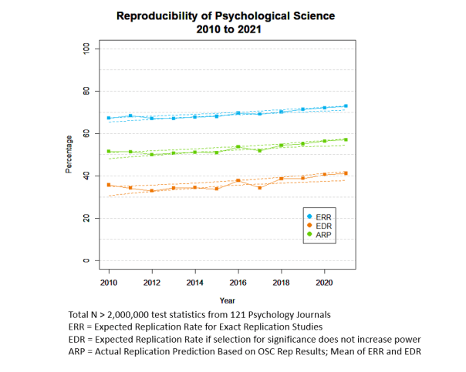
Improvements are slow
Statistical estimates (Schimmack, 2022)
Notes:
42% ARP in Journal of Occupational and Organizational Psychology (other OP journals somewhat better)
Very imprecise method!

Slide 10
Notes:
This matters because science is cumulative and depends on trust – if findings are not robust, we can’t build on them – and not expect practitioners to do so either.

Slide 11
Why is this happening
Fraud (e.g., data fabrication/modification)
2% of scientists admit to having done this at some point (Fanelli, 2009)
Can be caught
E.g., SPRITE analyses of Wansink’s eating experiments
Data review of honesty experiment involving Nobel prize winner (datacolada.org)
More important: Questionable Research Practices
Notes:
https://www.theguardian.com/science/2017/jun/27/profitable-business-scientific-publishing-bad-for-science
Good assessment of Elsevier’s market position by a business analyst:
https://infrastructure.sparcopen.org/landscape-analysis/elsevier#:~:text=Elsevier%20operates%20at%20a%2037,operates%20at%20a%2023%25%20margin.

Slide 12
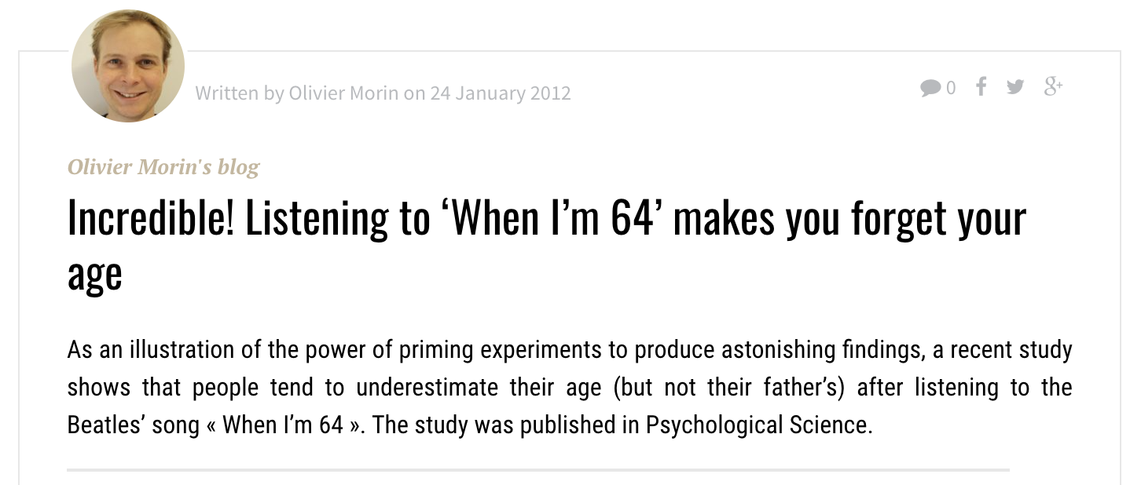
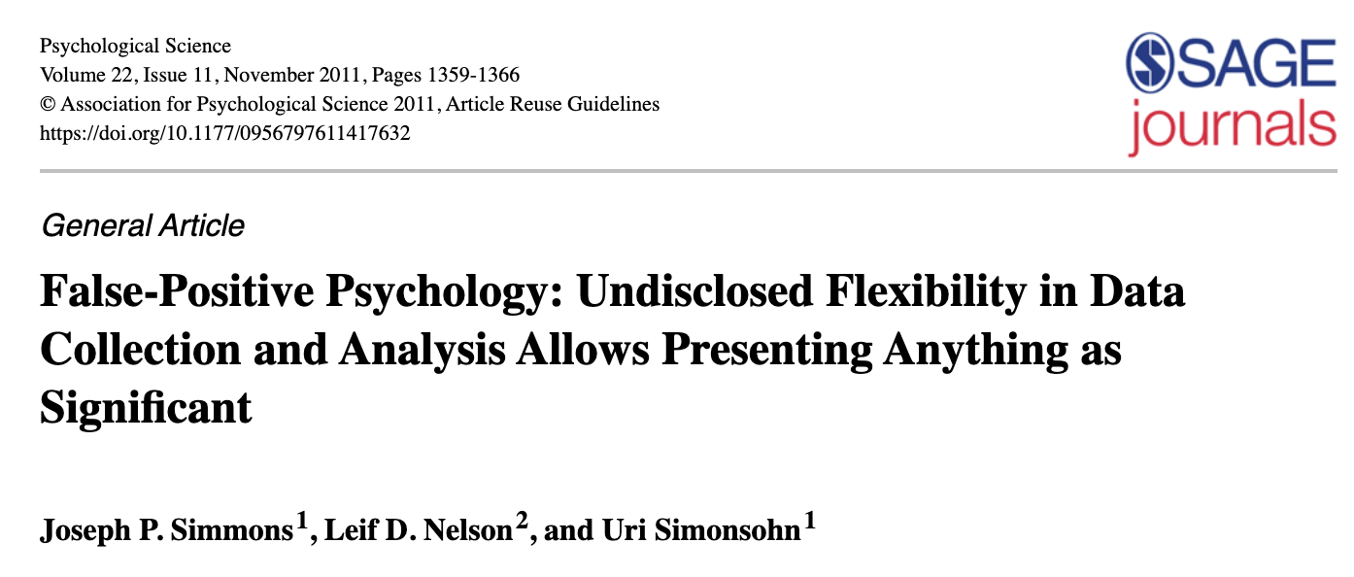
The power of music

Slide 13
How did they do it?
Include unreported conditions (3 songs)
Include many potential dependent variables
Include many potential control variables
Check for statistical significance after every 10 participants
Selectively use control variables
No fabrication of any data or statistical mistakes

Slide 14
Source:
explainxkcd.com

Slide 15
Source:
explainxkcd.com
Notes:
This is called p-hacking

Slide 16
Choices are inevitable
Link

Slide 18
Pre-registrations
Create a fixed record of your plan before data collection
Analysis strategy, including choices that can easily become data-driven/self-serving
Tests to be run, variables to be used
Exclusion criteria (outliers, missing data)
Currently debated and adapted for qualitative research (e.g., Haven & Grootel, 2019)
Often not published instantly, but ideally automatically after set period (as record of attempted research) – depends on platform

Slide 19
Pre-registrations
Simple format for quantitative research
Further templates (e.g., qualitative research)
For systematic reviews, e.g., https://bit.ly/syst-reviews
Notes:
Tool for transparency – plans can and will change, but needs to be recorded

Slide 20
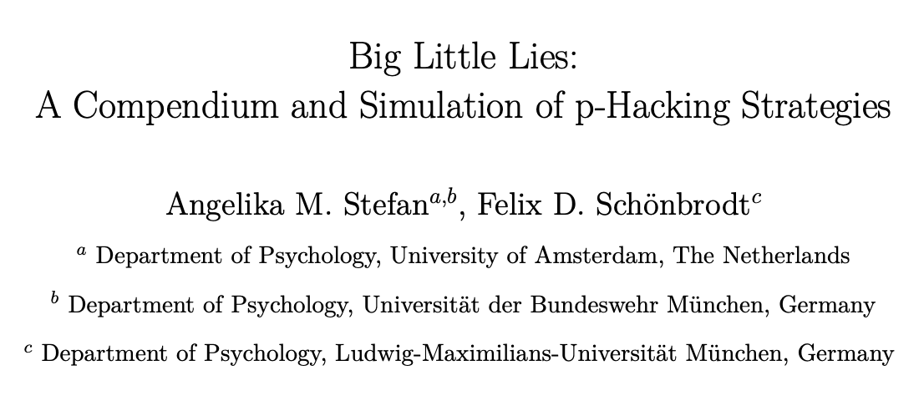
Even without that, key risks can be avoided
Many long lists of QRP exist – here I follow this one

Slide 21
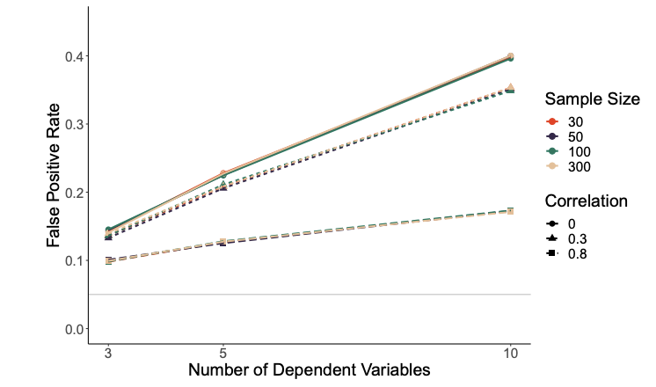
Selectively reporting DVs
(or IVs)
Note: selective interpretation is also problematic

Slide 22
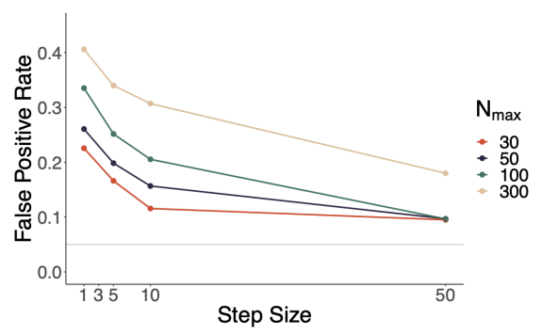
Optional stopping during data collection
Can correct for such multiple comparisons - increases efficiency. See Lakens (2014)

Slide 23
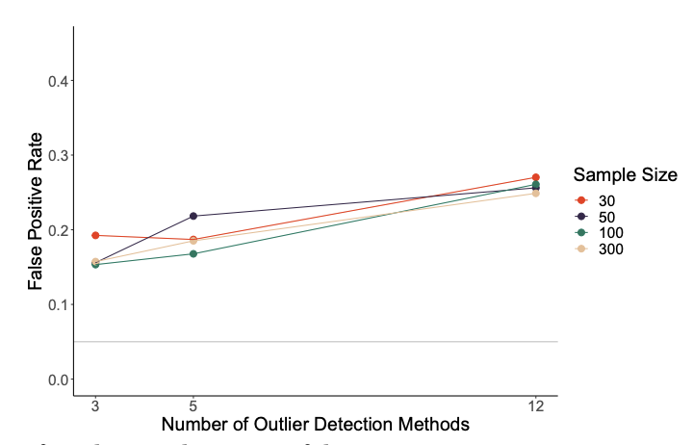
Purposeful outlier exclusion
Baseline rule: always report results for full sample, in addition to adjusted results
Notes:
Identified 12 outlier selection techniques that are used in the literature – so lots of freedom here

Slide 24
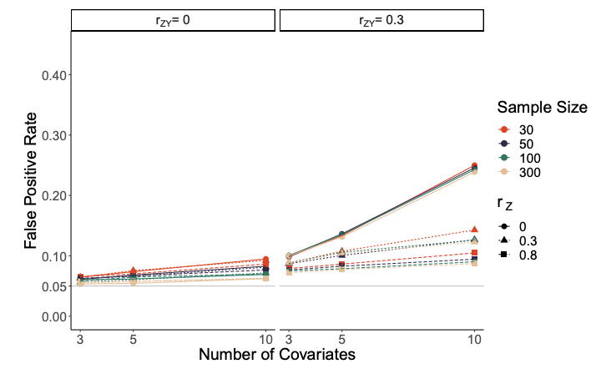
Selectively including covariates
Baseline rules:
always report results for full sample, in addition to adjusted results
Use theory (and independent data) to select covariates – never the study’s data
Notes:
Identified 12 outlier selection techniques that are used in the literature – so lots of freedom here

Slide 25
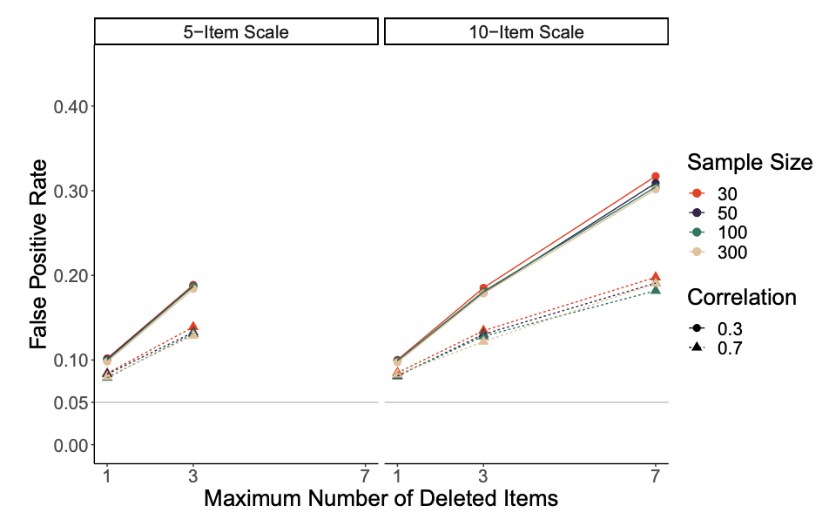
Selectively excluding items/redefining scales
SPSS reports Cronbach’s alpha when item deleted
Baseline rules:
Do not delete items just based on data
Report such re-definition!

Slide 26
Selectively transforming variables
Using logarithm, reciprocal or square root transformation
Beware: data was generated from normal distribution, so this is (unrealistic?) best-case scenario
Baseline rules:
No need to transform variables just because they are not normal
Check and report distribution of residuals

Slide 27
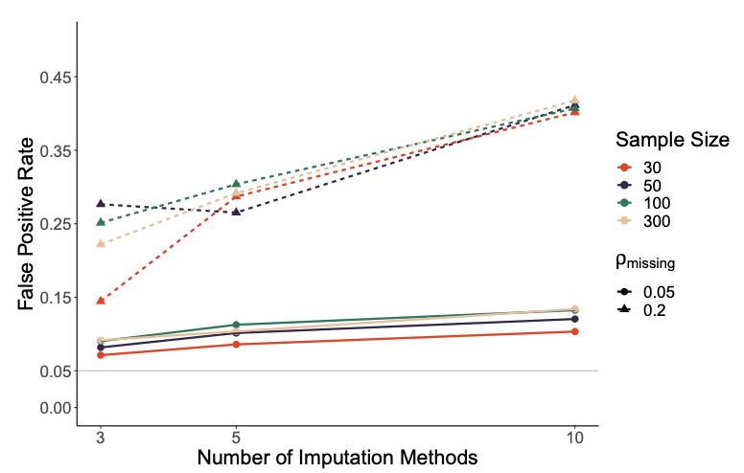
Imputation of missing data
Estimating missing values pre-analysis – essential (!) when data is not missing completely at random (example)
Baseline rules:
Avoid missing data, or ensure that it is missing completely at random
If not, decide on one approach in advance, and follow current guidance (i.e., FIML or MI)

Slide 28
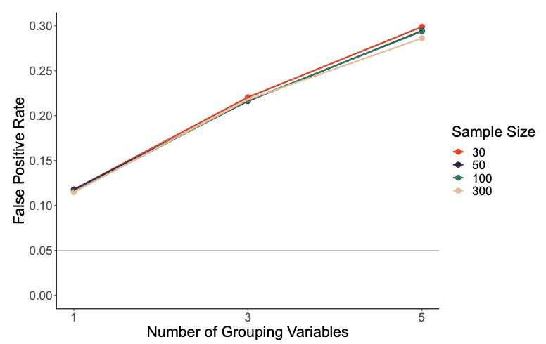
Ad-hoc subgroup analyses
Either reported (e.g., is there an effect for men at least), or through redefinition of inclusion criteria (e.g., no part-timers)
Baseline rules:
Avoid ad-hoc analyses without justification; report justified analyses as exploratory
Correct for multiple comparisons in (limited) set of planned subgroup analyses

Slide 29
Further issues
Selectively discretizing variables (e.g., splitting them into categories)
About 10% false positive rate, if cut-offs are not manipulated
Selectively choosing parametric vs non-parametric tests
Limited impact in simulations with normally distributed data
But: choice should not be based on outcome
Incorrect p-value rounding:
Convention is p < .05 is significant, so, p = .052 is not, even after rounding
Changing hypotheses based on data
Very problematic when used to ‘hide’ multiple comparisons and alternative variables that were collected
Statistically less problematic if direction is reversed (using two-tailed test) or hypothesis fully developed post-hoc (based on all tests conducted)
BUT: misleads reader regarding base rate, which matters for interpretation!
Selective publishing – of individual studies and entire articles

Slide 31
My summary
Replication crisis is ongoing; more robust findings needed for scientific progress and practical relevance
Shaky findings rarely a result of fabrication – but often of motivated choices in “garden of forking paths” and of incomplete reporting
Key issue: data-driven decision-making; thus need for pre-commitment/ pre-registration

