Slide 1
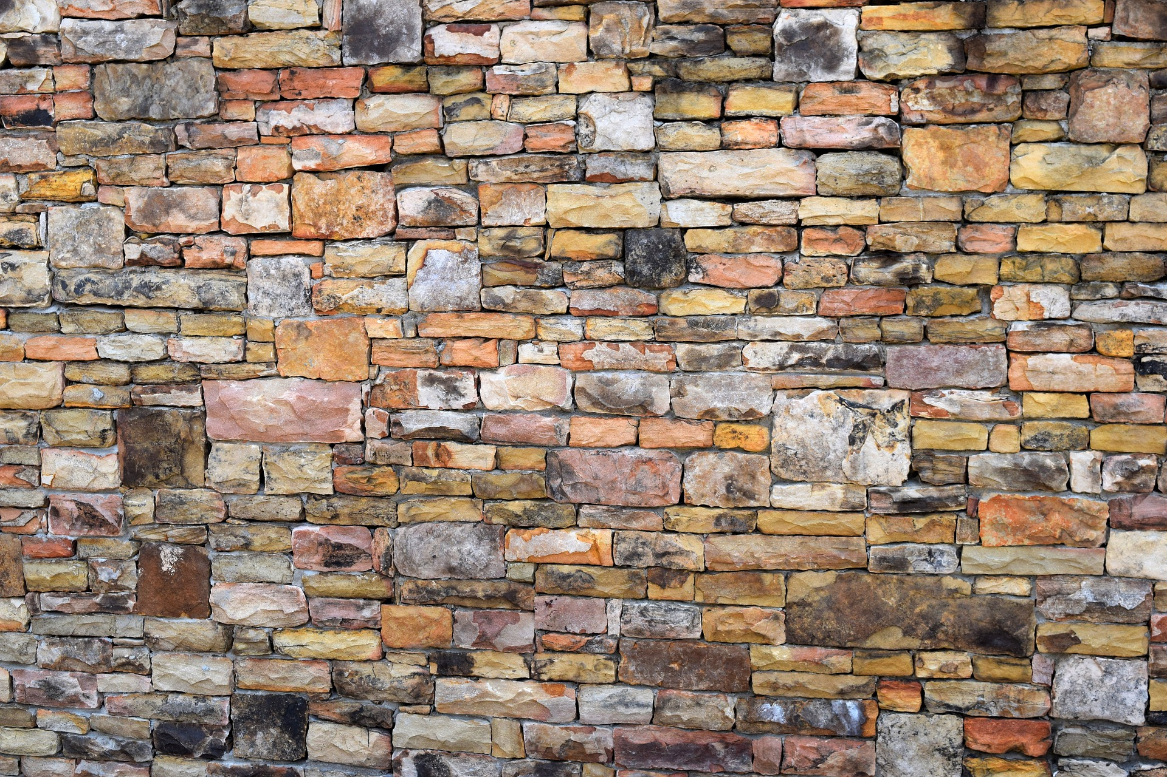
Lukas Wallrich (l.wallrich@bbk.ac.uk) .
Open Science
Why do we need it?
How can you get involved?

Slide 2
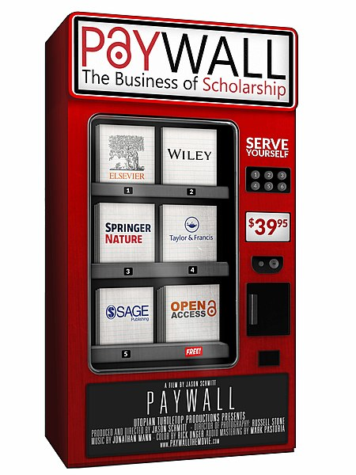
Open Science

Slide 3
Not just about Open Access
Open Data
Open Access
Open Methods
Open Process
Open Education
Open Source
Notes:
Accessible
Free
Transparent

Slide 4
Why?
“We believe that the move towards openness will lead to increased transparency, better quality research, a higher level of citizen engagement, and will accelerate the pace of scientific discovery through the facilitation of data-driven innovation.”

Slide 5
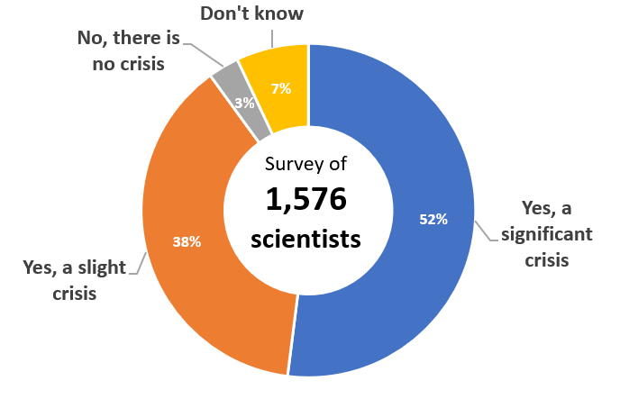
Address replication crisis
Nature survey: is there a reproducibility crisis?
Notes:
Mix of problematic research practices, misunderstandings, and wrong motivations …

Slide 6
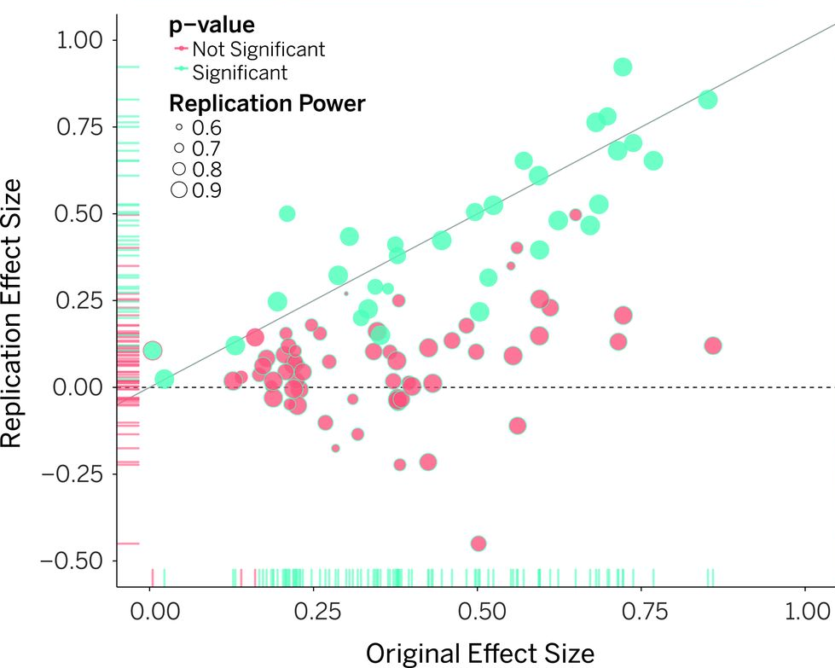
Estimating the reproducibility of psychological science
Notes:
1/3 reproducible
Average effect size: ½ of original effect size
https://www.science.org/doi/10.1126/science.aac4716

Slide 7
Liberate knowledge
Libraries or researchers need to subscribe to expensive journals
Especially for-profit journals
UK libraries pay GBP 200m per year
Most of the work is done for free* (research, writing, peer-reviewing), leading to healthy profits (38% for Elsevier in 2018, 23% for Nature)
Journals need to sell subscriptions, favouring “exciting” articles
Alternatives:
Publishing charges
“Predatory” publishers
“New” journal models
E.g., PsychOpen
Self-archiving (after embargo period)
Open Access Button
* That is, paid for by funders, students and tax-payers.
Notes:
https://www.theguardian.com/science/2017/jun/27/profitable-business-scientific-publishing-bad-for-science
Good assessment of Elsevier’s market position by a business analyst:
https://infrastructure.sparcopen.org/landscape-analysis/elsevier#:~:text=Elsevier%20operates%20at%20a%2037,operates%20at%20a%2023%25%20margin.

Slide 8
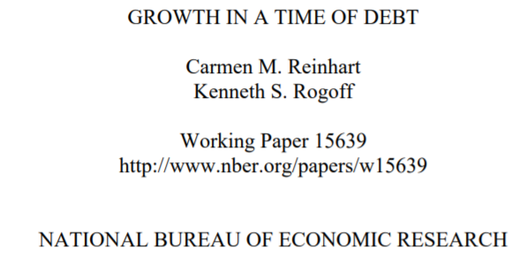
Liberate data
Publish data alongside articles
Required by many top journals
Allows for reproduction

Slide 9
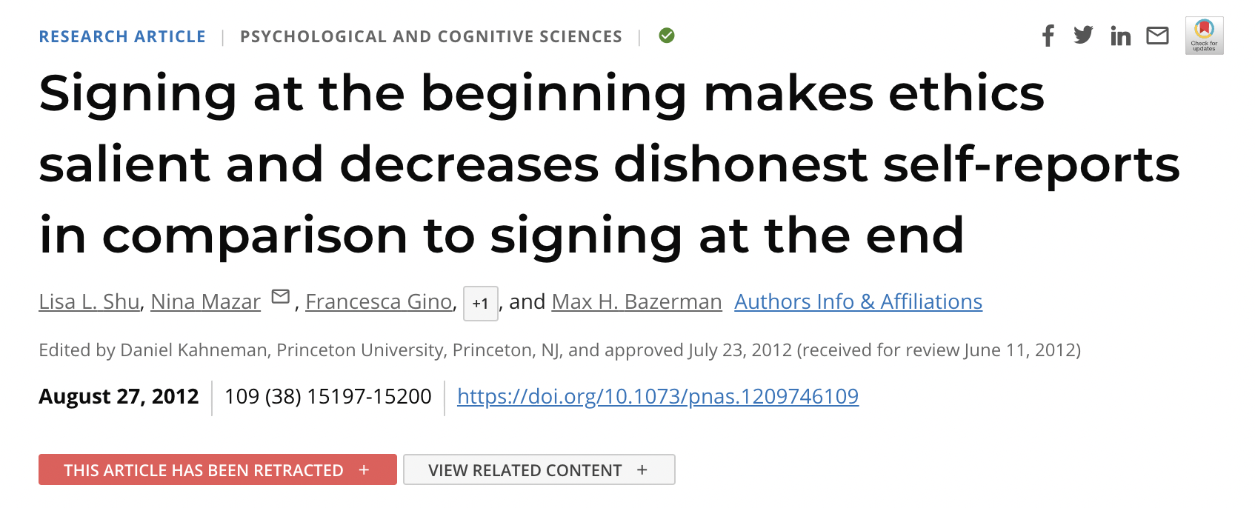
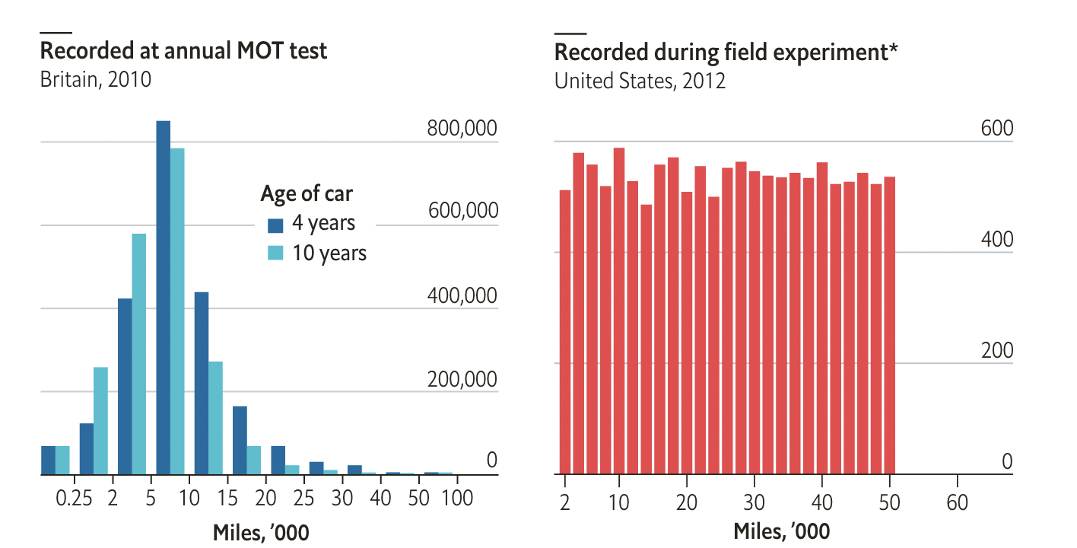
Liberate data
Chart: economist.com / original story: datacolada.org
Notes:
Co-authored by a Nobel prize winning economist – who now (plausibly) suggests that he can’t audit all data
Cited 500 times, retracted a decade later

Slide 10
Liberate data
Publish data alongside articles
Required by many top journals
Allows for reproduction
Allows for secondary analyses
Publish data that is not written up (e.g., null-findings in file drawer)
Significant results more likely to get published, which biases the literature
Initiatives to change that (e.g., Registered Reports) but unlikely to close the gap entirely
Publishing documented data easy first step to make null-results available

Slide 11
Open qualitative data
Likely even greater reuse potential than for most quantitative data – e.g., different methodology, triangulation
Potentially harder to anonymise – but possible, and good guidance exists
Check UK Data Service for guidance and examples, e.g., on dress codes at work

Slide 12
Open methods & open process
Science takes place in “a garden of forking paths” (Gelman & Loken, 2014)
Silberzahn et al. (2018)

Slide 13
Open methods & open process
Science takes place in “a garden of forking paths” (Gelman & Loken, 2014)
Qualitative researchers have recognised this for much longer, but don’t always act on it
Quantitative researchers need to either show discipline (e.g., detailed pre-registrations) or embrace subjectivity with need for transparency

Slide 14
Pre-registrations
Create a fixed record of your plan before data collection
Analysis strategy, including choices that can easily become data-driven/self-serving
Tests to be run, variables to be used
Exclusion criteria (outliers, missing data)
Currently debated and adapted for qualitative research (e.g., Haven & Grootel, 2019)
Often not published instantly, but ideally automatically after set period (as record of attempted research) – depends on platform

Slide 15
Pre-registrations
Simple format for quantitative research
Templates for qualitative research
For systematic reviews, e.g., https://bit.ly/syst-reviews
Notes:
Tool for transparency – plans can and will change, but needs to be recorded

Slide 16
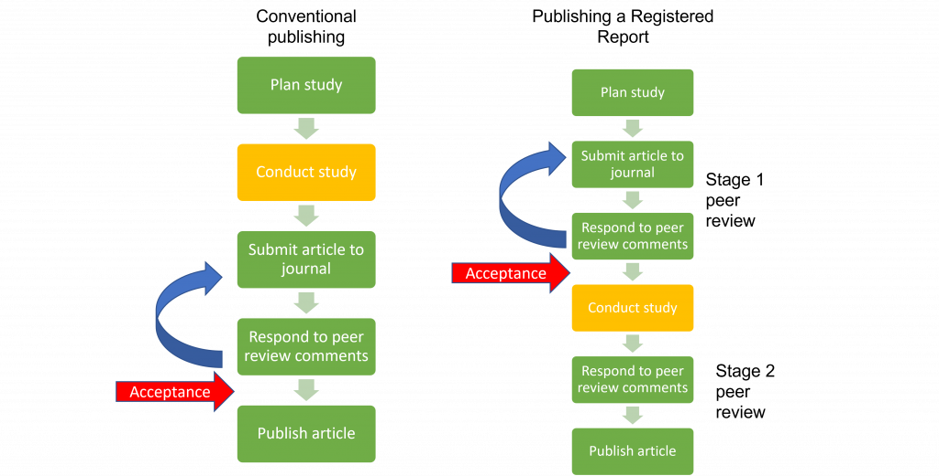
The new ”gold standard”? Registered Reports

Slide 17
Open Source software
Analysis code is part of methods, should be published – can be done at high level in SPSS, but underlying code is IBM’s ‘secret’
Code can only be checked and reused by people with SPSS licence (min. 99 USD per month outside academia!)
Alternative: Open Source software developed by community of scientists and users, free to use and open for inspection ‘under the hood’

Slide 18
Open Source software
Traditionally, very powerful, but with steeper learning curve
More recently, tools with graphical user interface have much improved
SPSS-like
But better ☺

Slide 19
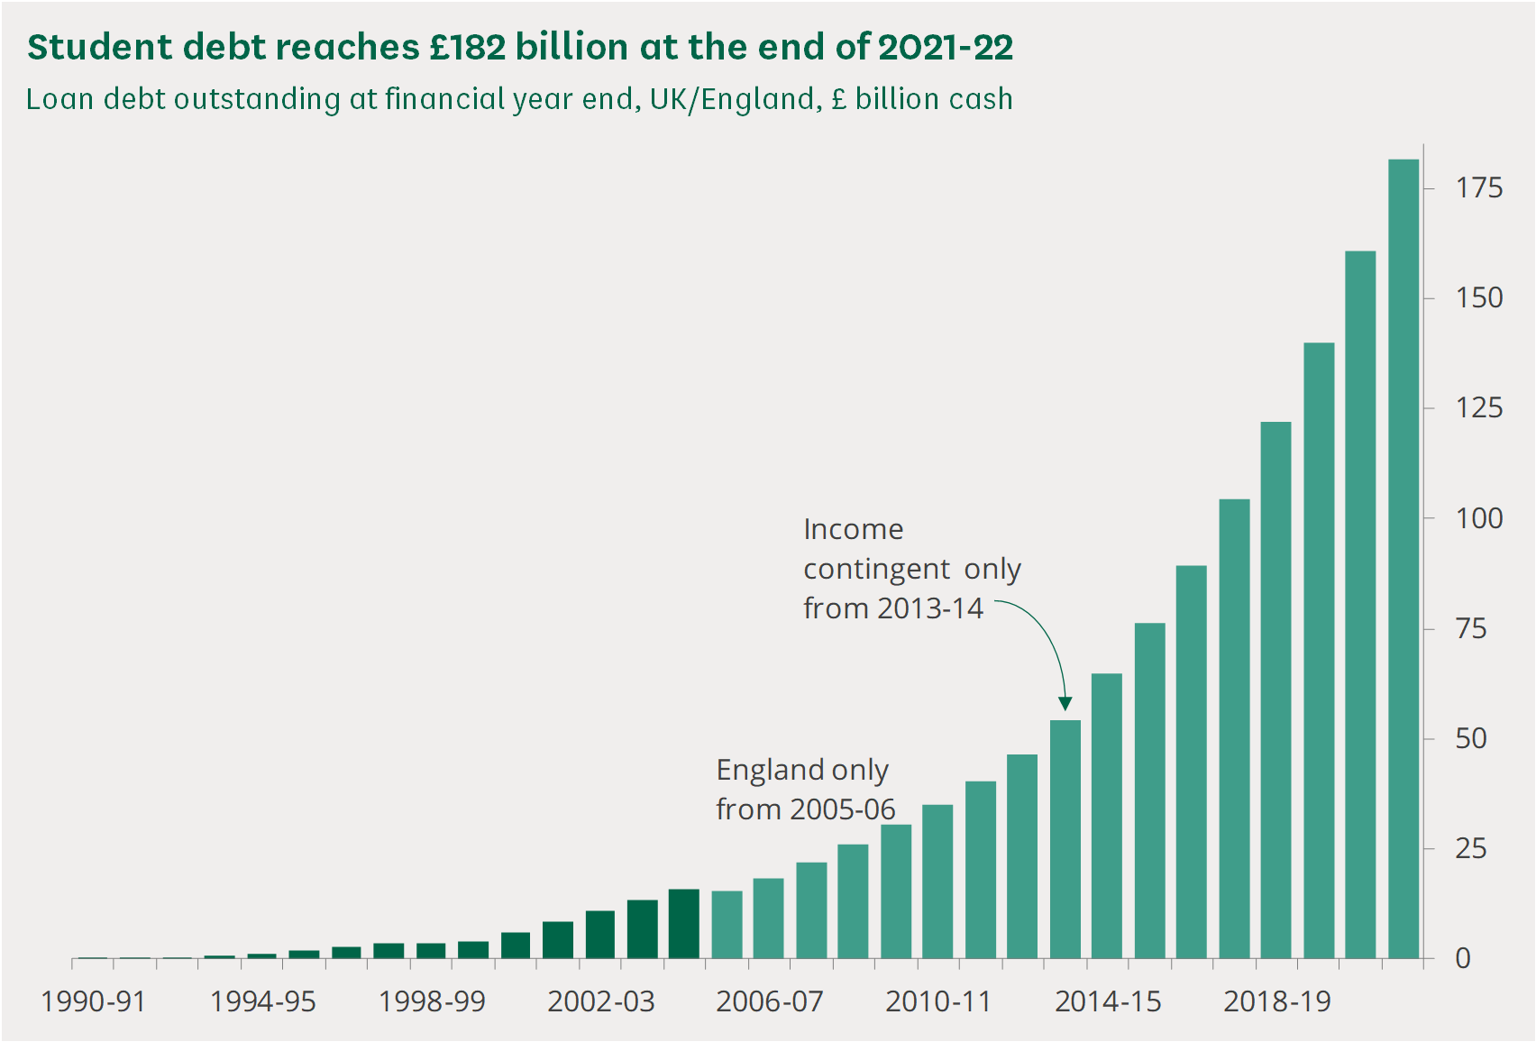
Liberate teaching materials
Education increasingly expensive
Source: House of Commons Library
Notes:
Same time: increasing student numbers & increasing workload for academics

Slide 20
Liberate teaching materials
E.g., several million students take undergraduate psychology courses each year
Each university develops own teaching materials, and buys expensive ageing textbooks → inefficient
Alternative: licence materials under Creative Commons (or similar), share, adapt and jointly improve (e.g., PsyTeachR at University of Glasgow), create open texbooks (e.g., SPSP)
Reduce cost, improve quality, free up time and promote access

Slide 21
Open Science at Birkbeck
College has rather ambitious Open Research Policy
Short and long-form output (articles and books) must be freely available online, and licenced under CC BY
Articles immediately, at least the AAM
Books within 12 months
Research data should be deposited on BiRD, ideally open access – “available on request” not enough
Notes:
Not sure about compliance – and obviously this does not apply to data you own/work that you have copyright over … but might be an inspiration

Slide 22
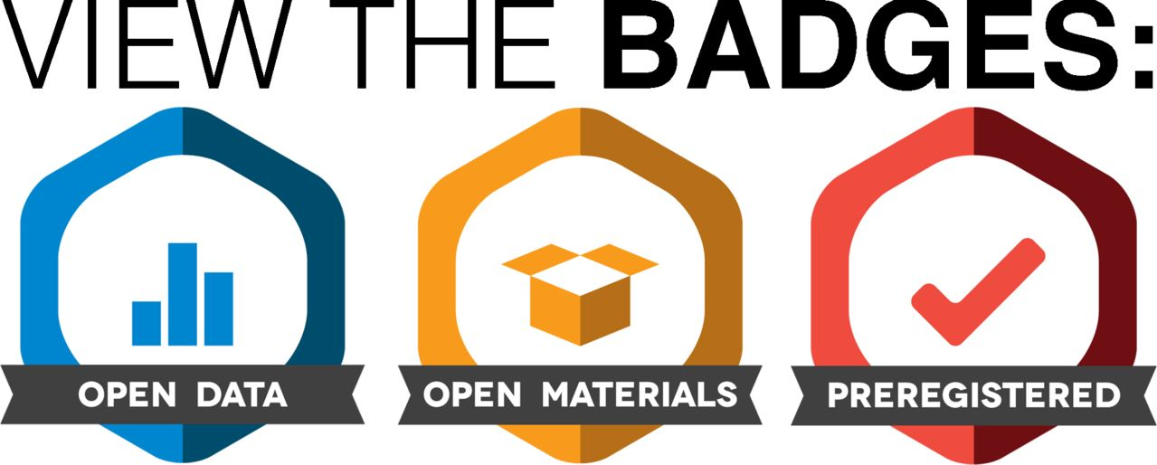
Get involved with Open Science
Use and cite public data, where appropriate
Share your data and materials, e.g., on osf.io (within ethical and legal limits, cf. McGrath & Nilsonne, 2018, for interview data)
Share your results, in diamond/platinum open journals, e.g., Journal of Work and Organisational Psychology, or as pre-prints, e.g., on PsyArXiv
Look for articles that embrace Open Science, and recognise their advantages
Notes:
PsyArXiv - Now on Google Scholar

Slide 23
My summary
Open Science is a broad and diverse movement to open up
Access to publications (and copyright to allow derivatives)
Data
Methods / code
Teaching materials
Can support the mission of academia
To create robust and replicable knowledge
To create public knowledge
To influence practice
To “stand on the shoulders of giants”
Challenges remain
Business models
Incentives
Best application to qualitative research
Everyone can contribute

